Slide 1


Annual Report
2024 – 2025

Slide 2



Acknowledgement
of Country
Women's Health East acknowledges the Wurundjeri Woi-wurrung people, the Traditional Owners of the land on which we work. We pay our respects to Elders past, present and future.
We affirm that sovereignty was never ceded, and that colonialism and racism continue to impact the lives of Aboriginal and Torres Strait Islander women and contribute to the high rates of violence they experience.
We recognise the strength, resilience and leadership of Aboriginal and Torres Strait Islander women and express our hope for, and commitment to, reconciliation.

Slide 3
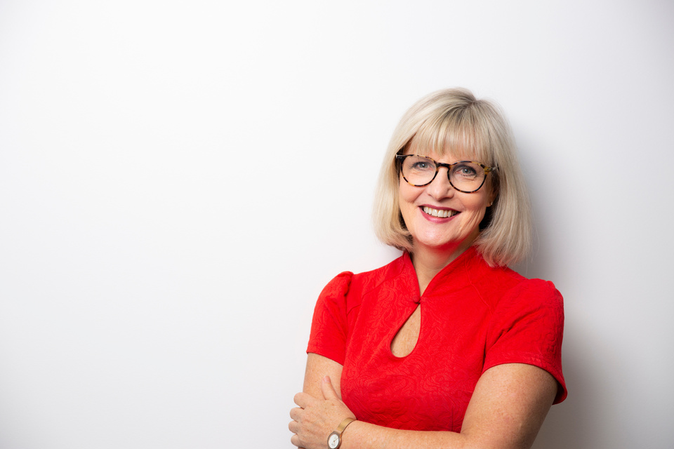
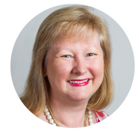
Message from the Chair
This year saw the successful delivery of the final phase of our current strategic plan. The Board continued to provide strong oversight while also turning its attention to emerging trends and priorities, laying the foundation for a refreshed strategy to be launched in 2026.
Recognising the value of collective action and shared impact, we are proud to have initiated a joint meeting of Chairs and CEOs from all 12 women’s health services across Victoria to explore new opportunities for collaboration.
The Board undertook a comprehensive review of our risk register and key governance policies with generous pro-bono support from Ashurst.
In September 2024, we welcomed Fiona Sharkie as Acting CEO whilst Elly Taylor was on parental leave. Fiona brought steady leadership and renewed strength to the organisation during her time. In August 2025, we farewelled our CEO Elly Taylor, a champion for women’s health and gender equality. We thank Elly for her leadership and commitment to women, girls and gender-diverse people in Melbourne’s east and wish her well in her future endeavours.
We also bid farewell to Board Members Belinda Li-Veldhuizen and Stephanie Kilpatrick, and we thank them both for their valuable contributions. Joanne Cleary joined the Board in 2024.
Message from the Acting CEO
It has been an exciting year to be part of Women’s Health East and a strong reminder of the power of place-based work. Our focus on the specific needs of women and gender diverse people where they live enables us to build trust, respond locally and make lasting change.
Supporting marginalised communities remains at the heart of our work. Our engagement with Chin- and Mandarin-speaking women and Disabled young people – through programs like Harmony Circle and Get the Go-Ahead – exemplifies the impact of being embedded in our region.
We have strengthened the capabilities of organisations to drive systemic change, with standout partnerships including Yarra Ranges Council, Yarra Valley Water, and Training for Respect across TAFEs and Registered Training Organisations (RTOs).
Despite a more constrained funding environment, our impact continues to grow.
We remain committed to long-term, local action that builds equity and prevents violence against women in Melbourne's east.
Fiona Sharkie
Acting CEO, Women’s Health East
Lisa Dunlop
Chair, Women’s Health East
Women’s Health East Annual Report 2024–2025

Slide 4



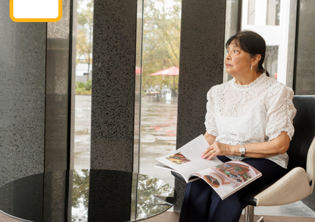
Growing stronger together
Sexual and reproductive health
We released our Innovate Reconciliation Action Plan developed in collaboration with Aboriginal and Torres Strait Islander women, cementing our commitment to listening, learning and walking together towards reconciliation.
We led a growing partnership to deliver A Strategy for Equality (2020–2025), advancing the sexual and reproductive health of women and gender-diverse people in Melbourne’s east. The 39-member partnership meets quarterly to share insights and training opportunities. The strategy has been evaluated, with a new 2025–2030 plan to be launched in 2026.
Team resilience and capacity was strengthened through Emotional Resilience Training for all staff.
9 workshops
enhanced knowledge among 175 health and community professionals. Sessions focused on, and were co-designed with, priority groups.
We introduced internal insights sessions where staff share learnings from their work so that we can collaborate, innovate and celebrate more effectively.
All 7 local governments
in our region received tailored sexual and reproductive health snapshots to support the development of their new health and wellbeing plans.
14 Chin women
“Today was very relevant to my work as a sexual
health clinician.
The content was directly applicable and it's easy to see what I can do differently.”
accessed cervical screening supported by Women’s Health East and EACH; many of whom would not have done so otherwise.
296 women
attended in-language sessions on cancer screening, pregnancy, birth, postpartum care and abortion healthcare.
“I have not done cervical screening since pre-COVID, but now I get a chance to with the help of Women’s Health East.”
Workshop participant
Chin community member
Women’s Health East Annual Report 2024–2025

Slide 5
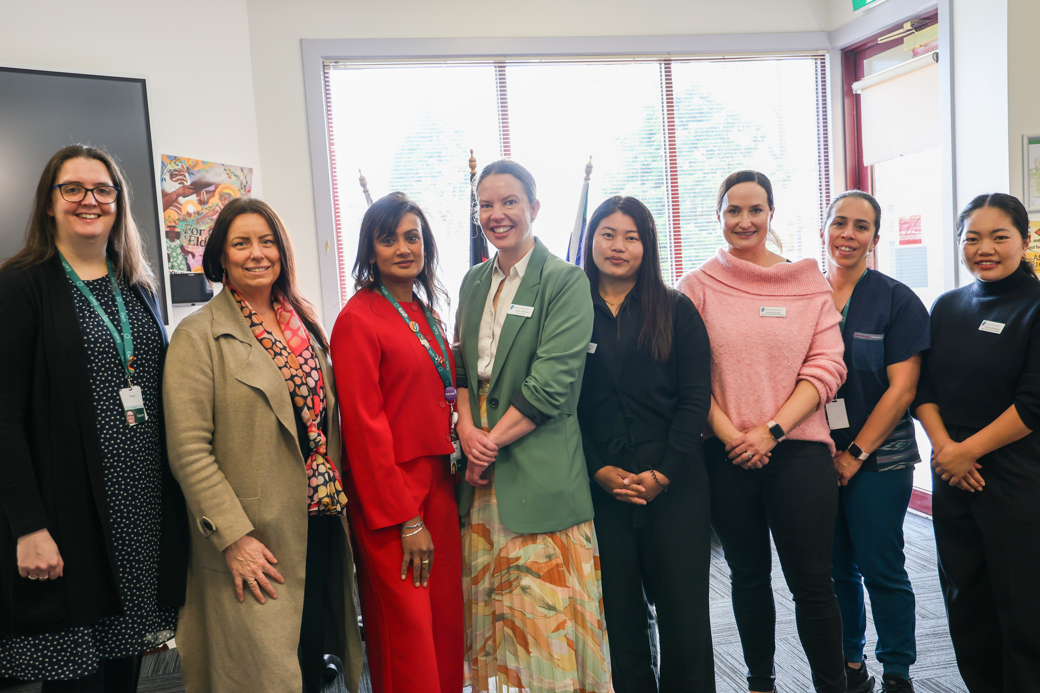
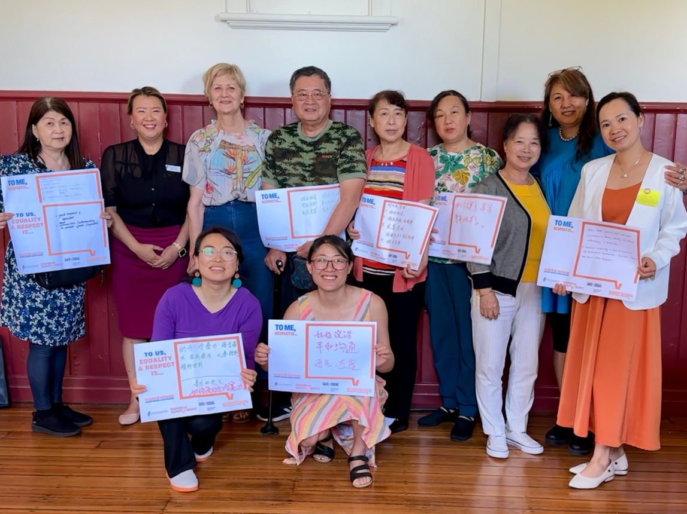
Mental health
910 Mandarin-speaking people participated in 44 culturally tailored mental health and wellbeing sessions across Whitehorse, Monash, Knox and Manningham. Some sessions included a visit to a leisure centre to introduce participants to local exercise options.
“I loved that we could try new things for free.
I’ve now signed up for a pass and intend to keep going.”
The Warburton/Redwood playgroup, delivered in partnership with a local community centre, provided a social connection program for isolated mothers of preschool-aged children. Participants reported feeling more connected and confident to better their mental health.
Our financial literacy sessions helped 165 women take control of their finances, including 107 Chin-speaking women, through our in-language financial literacy sessions.
Session participant
Over 50 people attended our Recognising Women in Place webinar, hearing inspiring case studies and understanding local governments’ role in gender equitable place naming.
237 Chin women took part across 21 sessions supporting refugee and migrant women’s mental health and wellbeing. Sessions included information on mental health, wellbeing and activities to build social connection.
“I started implementing a budget on Excel right after the seminar.
I know I can do better by actually budgeting instead of just living pay to pay.”
Money Matters
webinar participant
Women’s Health East Annual Report 2024–2025

Slide 6



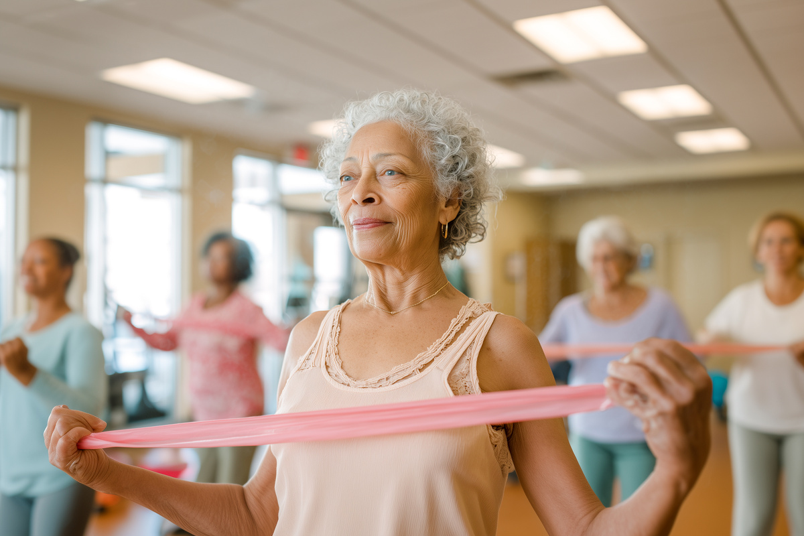
Gender equality
We provided specialist gender equality services, including our work with:
We participated in Training for Respect, a project led by Women’s Health in the South East and funded by WorkSafe Victoria’s WorkWell Respect Fund, to prevent sexual harassment and gendered violence in the vocational education sector. We delivered training to 154 staff and students, alongside online learning and resources to help foster safe, respectful learning environments.
Yarra Ranges Council on their Disability Action Plan 2025–2029.
Women’s Health Goulburn North East on planning tools for councils.
  Yarra Valley Water to improve equity in its $1.2 billion maintenance contract.
Our You Can Ask That webinar engaged 29 participants from education, training and government sectors, who left feeling more confident to address workplace gendered violence.
We engaged 281 staff across government, utilities and education through 14 workshops on gender equality and gender impact assessments (GIAs). Participants from the Department of Health, Yarra Valley Water and Box Hill Institute reported greater confidence to conduct GIAs.
Chronic disease prevention
“I now understand the importance of actively shaping a respectful, inclusive culture through leadership, policy and everyday interactions.”
This Girl Can, delivered with Yarra Ranges Council, Eastern Health and Inspiro (now Access Health and Community), offered 100 free or low-cost activities to encourage women, girls and non-binary people to get active. 80% reported greater confidence to be more active in the future.
Gender equality
training participant
With Women’s Health In the North, we helped the North Eastern Public Health Unit embed an intersectional gender lens in chronic disease prevention by reviewing their planning tools and delivering a workshop on gender equity in healthy eating.
“[I learned] to consider the different people in our community, the impact our work has on them... and how to weave those things into our work.”
Gender equality training participant
Women’s Health East Annual Report 2024–2025

Slide 7

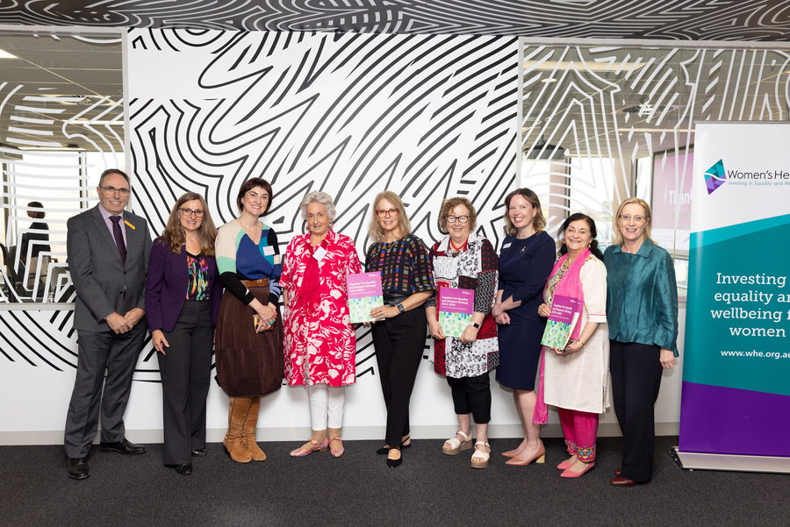
Prevention of violence against women
21 active bystander sessions reached 496 people from councils and state government, including 95% of Yarra Ranges Council staff. Participants gained confidence to challenge disrespect.
Together for Equality and Respect (TFER) took great steps towards a bold new plan for preventing violence against women. We undertook extensive consultation with partners and the community to inform the partnership’s 2025–2029 strategy. TFER currently has 35 member organisations.
In partnership with TFER and others, we delivered five impactful 16 Days of Activism events that reached 460 people across Melbourne’s east, including:
Margins to the Mainstream held a showcase and bid for the statewide expansion of this proven program to prevent violence against women with disabilities. 180 people attended the event, run in partnership with Women with Disabilities and other women’s health services. Although the expansion bid was unsuccessful, our advocacy elevated the issue and promoted a proven solution to governments as well as health and family violence organisations.
We developed 25 original resources to equip partners to strengthen engagement with diverse communities. Our Mandarin resources alone reached 690 WeChat users. Translated materials are available through the Health Translations Library.
Vital community conversations among Chin- and Mandarin-speaking women.
A Family Violence march in partnership with Boorndawan Willam Aboriginal Healing Service that saw Aboriginal Community Controlled Organisations and TFER partners walking together for respect.
Delivered in partnership with Youth Disability Advocacy Service and supported by the Victorian Government, Get the Go-Ahead is a deeply collaborative project to increase access to affirmative consent information, empowering young people with disabilities to make informed choices and reducing the drivers of gendered and sexual violence.
We launched a series of print and video resources, co-designed with a dedicated team of 10 young people living with disabilities.
“Caring for our communities is an incredible resource.
This will be very helpful
to share with all young people, with disabilities
and without.
The breadth of these resources is very impressive.”
Practitioner working with Disabled young people
Women’s Health East Annual Report 2024–2025

Slide 8
Thank you!
We acknowledge the invaluable contribution of our peers and partners to enhancing women’s health, safety and wellbeing.
Access Health and Community
ADRA
AusWise
Boorndawan Willam Aboriginal Healing Service
Box Hill Institute
Centre for Culture, Ethnicity and Health
City of Boroondara
Community Houses Association of the Outer East (CHAOS)
Deakin University
Department of Education
Doncare
EACH
Eastern Centre Against Sexual Assault
Eastern Community Legal Centre
Eastern Health
Eastern Metropolitan Regional Family Violence Partnership
FVREE
Gender Equity Victoria
GenWest
Gippsland Women’s Health Service
healthAbility
Independent Tertiary Education Council Australia
IndianCare
Jesuit Social Services
Knox City Council
Latrobe Community Health Service
Manningham City Council
Maroondah City Council
MiCare
Migrant Information Centre (Eastern Region)
Mitcham Christian Church
Monash City Council
Monash University
Multicultural Centre for Women’s Health
Network of Inner Eastern Community Houses
North Eastern Public Health Unit
Relationships Australia Victoria
Respect Victoria
Rotary Club Box Hill
Seniors Happy Life Club
Sexual Health Victoria
Swinburne University
The Orange Door-Inner East
The Orange Door-Outer East
Victorian TAFE Association
Whitehorse City Council
Whitehorse Manningham Libraries
Women with Disabilities Victoria
Women’s Health and Wellbeing Barwon South West
Women’s Health Goulburn North East
Women’s Health Grampians
Women’s Health in the North
Women’s Health in the South East
Women’s Health Loddon Mallee
Women’s Health Victoria
Yarra Ranges Council
Yarra Valley Water
Your Library
Youth Disability Advocacy Service
Our impact in 2024–2025 was made possible by funding and grants from:
Department of Health
Department of Families, Fairness and Housing
Office for Women
Department of Justice and Community Safety
North East Public Health Unit (NEPHU)
Respect Victoria
Safe & Equal
WorkSafe
We also thank the organisations that engaged our consultancy services. Proceeds from this work are reinvested into programs and projects that advance gender equality and positive social change for women and girls.
Women’s Health East Annual Report 2024–2025

Slide 9
Become a member
Financials
Women’s Health East’s membership is free and open to anyone who identifies as a woman and who lives, works or studies in Melbourne’s eastern region, and to organisations who work with women in our region.
The following information is an overview of the finances of Women’s Health East Inc. and should be read in conjunction with the Women’s Health East Inc. Financial Statements for the year ending 30 June 2025 and their accompanying notes, available at www.whe.org.au. Women’s Health East prepares its financial statements in accordance with the Australian Accounting Standards, as outlined in the Independent Auditor’s Report.
Benefits
  Eligibility to stand for election to the Women’s Health East Board of Governance
  Voting rights at Women’s Health East member meetings and Board of Governance elections
  Access to the latest updates on women’s health, safety and wellbeing through our e-newsletter
  Invitations to engage in community events and consultations
  Inclusion in a community of like-minded people dedicated to promoting equality, empowerment and the wellbeing of all women.
Total income for the 2024–25 financial year was $2,194,875, representing a 9.3% decrease from $2,420,758 in the previous year. Operating grants decreased by 9.3%, while fee-for-service revenue declined by 16.6%. Other income sources showed a modest increase. Total expenditure was $2,342,057, slightly lower than the previous year, with employment expenses decreasing modestly. This reduction partly reflects a constrained funding environment, which led to some staffing redundancies.
The result for the 2024–25 financial year was an operating deficit of $147,182, largely reflecting the recognition of staffing redundancies during the year. Women’s Health East’s current ratio of approximately 1.84:1 indicates that the organisation has $1.84 in current assets to meet every $1 of current liabilities. The current ratio is a standard calculation used to assess an organisation’s short-term financial liquidity.
Summary income statement
 | 2024-25 ($) | 2023-24 ($)
Income
Operating grants | 2,033,932 | 2,242,286
Fee for Service | 101,829 | 122,127
Other | 59,114 | 56,345
Total Income | 2,194,875 | 2,420,758
Expenditure
Employment expenses | 1,947,366 | 2,000,705
Other | 394,691 | 414,234
Total Expenditure | 2,342,057 | 2,414,939
Operating Profit/(Loss) | (147,182) | 5,819
How to become a member
 | 2024-25 ($) | 2023-24 ($)
Cash & Financial Assets | 844,701 | 962,318
Receivables | 51,741 | 55,187
Property, plant & equipment | 20.080 | 28,680
Total Assets | 964,424 | 1,116,195
Payables | 111,990 | 1,116,195
Income in advance | 83,327 | 146,284
Provisions | 291,494 | 198,300
Lease Liabilities | 52,115 | 72,879
Total Liabilities | 538,926 | 543,515
Net Assets | 435,498 | 572,680
Current Ratio | 1.84:1 | 2.14:1
Please complete a membership application on our website whe.org.au/support/ become-a-member
Please note that membership is contingent upon approval by the Board of Governance and is renewable every three years.
For more information, contact us at health@whe.org.au.
Women’s Health East Annual Report 2024–2025

Slide 10


Women’s Health East
1/125 George Street
Doncaster East
VIC 3109
health@whe.org.au
www.whe.org.au

